Slide 1

DEPARTMENT OF COMPUTER SCIENCE AND ENGINEERING
Professional Training I
Plant Disease Detection using Image Classification
PROJECT STUDENT GUIDE
S AMANULLAH FAZIL, 44111431 Ms. P. Kabitha

Slide 2
AGENDA
Certificate
Abstract
Introduction
Objective
System Architecture / Ideation Map
Module Implementation
Results and Discussions
Conclusion
References

Slide 3
COURSE CERTIFICATE

Slide 4
ABSTRACT
Plant diseases significantly affect crop productivity and can lead to substantial agricultural looses when not detected at an early stage. This project proposes an AI-based Computer Vision System to detect and classify plant diseases from leaf or crop images using Deep Learning and Image Processing. The system identifies disease-specific patterns and provides rapid, automated diagnosis. The proposed solution aims to support early disease detection, reduce crop losses, and improve agricultural productivity through smart farming technology by helping farmers monitor crop health, reduce potential losses and improve overall agricultural productivity.

Slide 5
INTRODUCTION
Plant diseases are a major challenge in agriculture affecting crop quality, productivity and food security. Early identification is essential to prevent diseases from spreading and reduce potential losses. Traditional disease detection mainly depends on manual inspection and expert knowledge which is time consuming and major threat for unexperienced farmers. This project aims to develop a Deep Learning - Based Computer Vision Model that identifies and classifies plant disease based on visual symptoms. The proposed system can support early disease detection, timely intervention, reduce major losses, and improved agricultural productivity.

Slide 6
OBJECTIVES
Develop an Automated Computer Vision system for detecting plant diseases.
Extract and learn disease-specific visual features such as spots, discoloration, lesions and texture changes.
Classify healthy and diseased plants accurately into their respective disease categories.
Improve the reliability and generalization of the model.
Enable early and efficient disease identification to timely treatment and reduce crop losses.

Slide 7
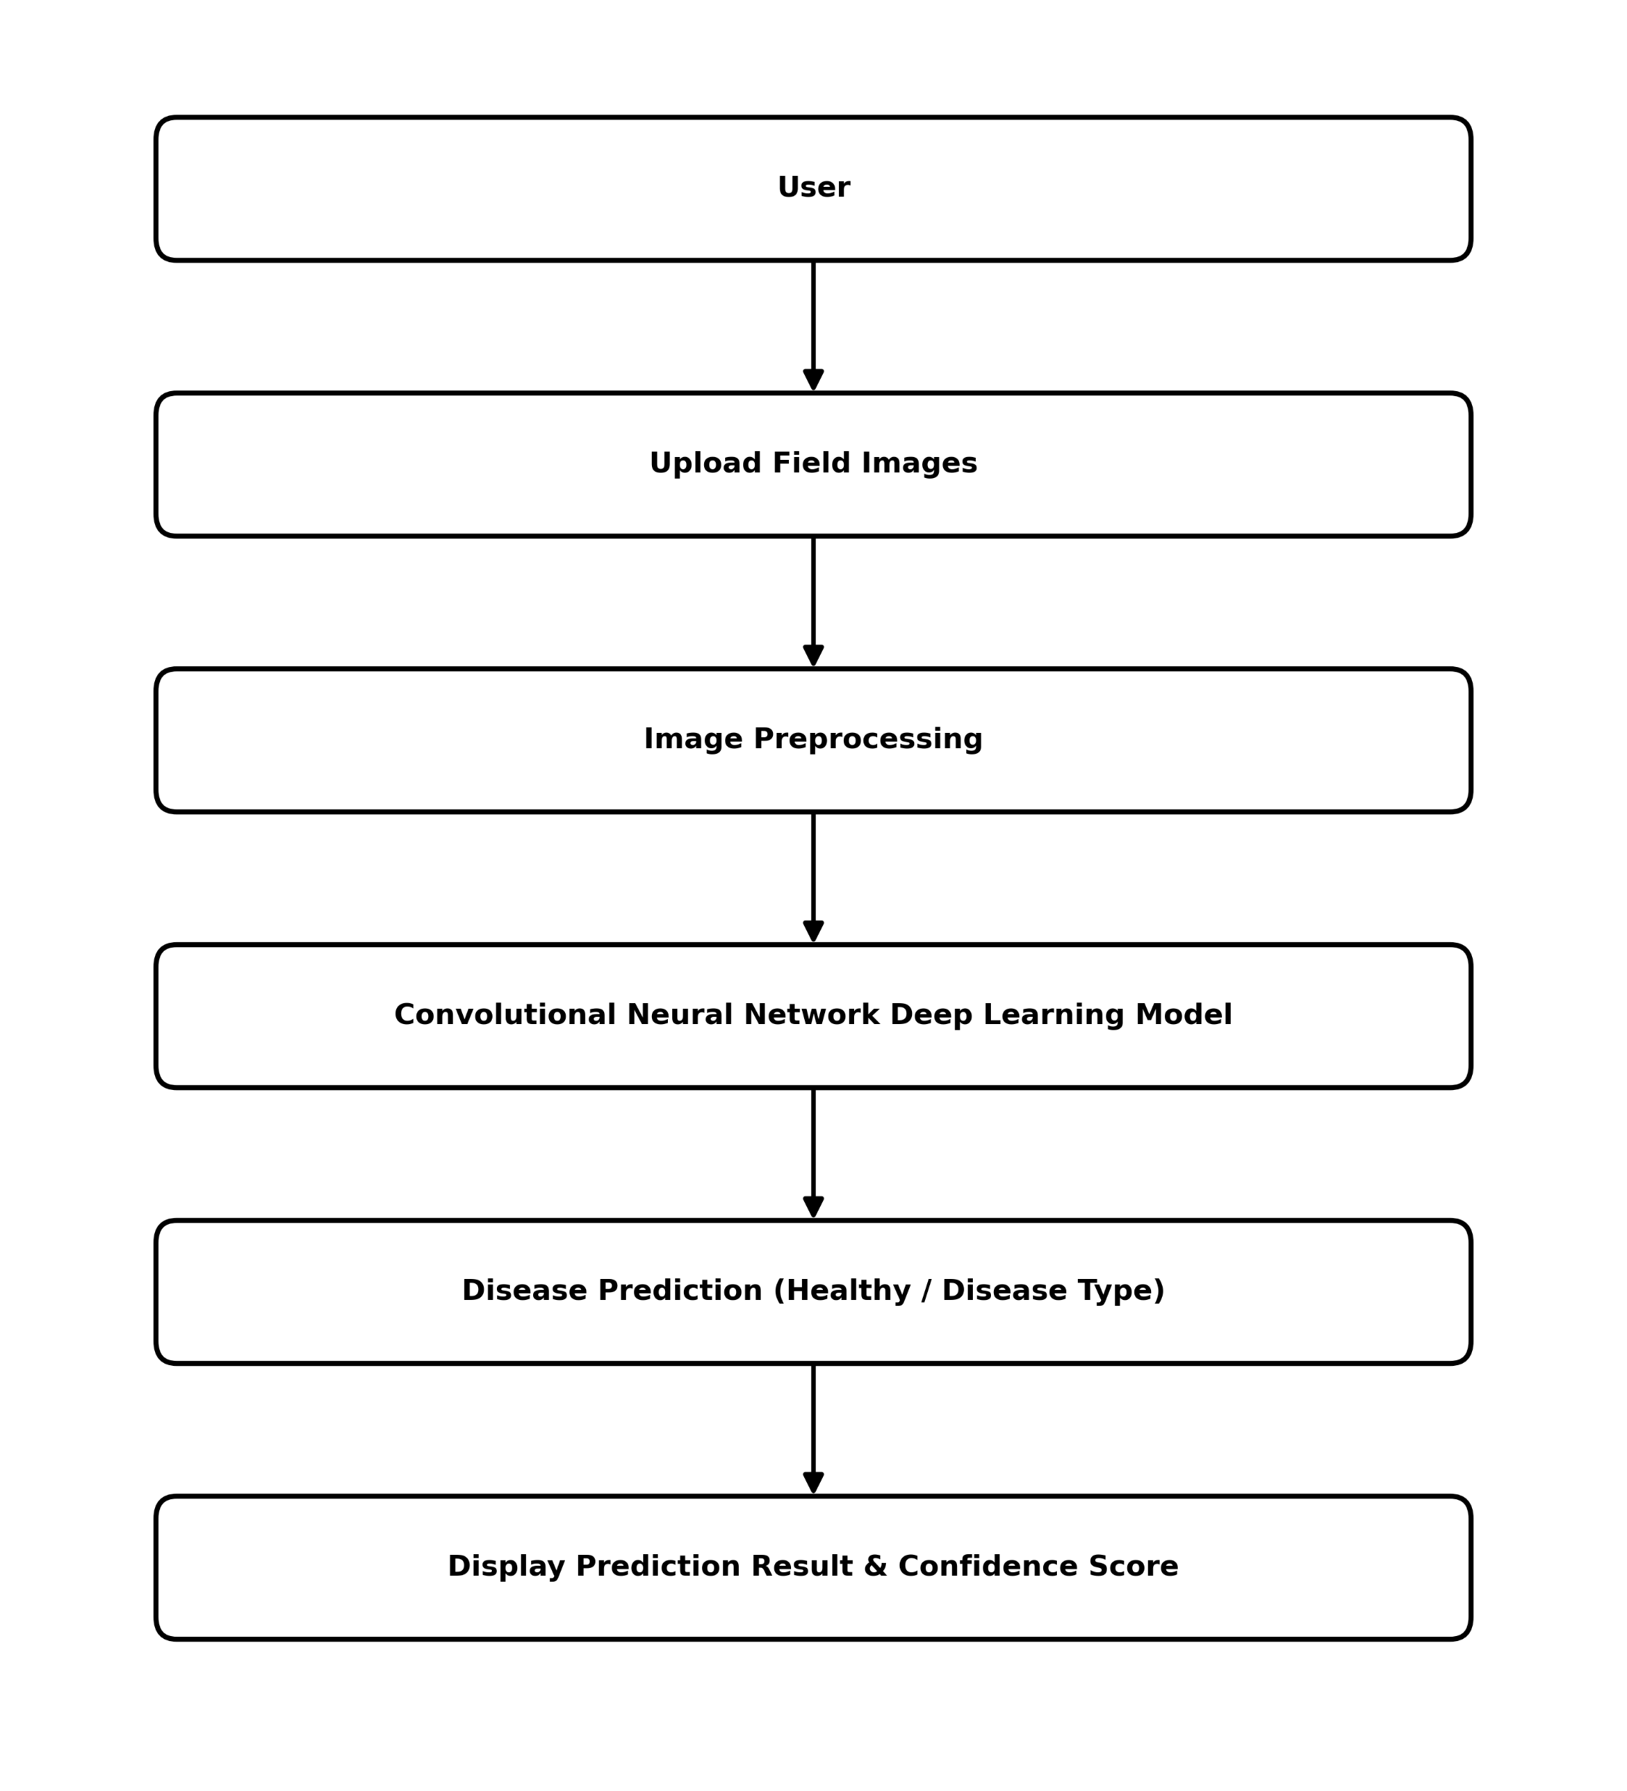
SYSTEM ARCHITECTURE

Slide 8
MODULE IMPLEMENTATION
M1: The User Uploads Crop/Plant Image.
M2: The Image is Resized, Normalized and Ready for Identification.
M3: Using CNN, The Model Classifies Whether Crop/Plant has been Affected or Not.
M4: Display of Prediction Output and Confidence Score.
M5: If Disease has been Identified, Display Disease Information.

Slide 9
RESULTS AND DISCUSSIONS
The developed system successfully analyses uploaded plant leaf images and identifies whether the plant is healthy or affected by a particular disease. The CNN model detects important visual features such as leaf spots, colour changes, lesions, and texture to classify diseases accurately. The system displays the predicted disease along with a confidence score and disease information making the result easy to understand. Overall, the project demonstrates the effectiveness of deep learning and image classification for automated plant disease detection.

Slide 10
CONCLUSION
The Plant Disease Detection System provides an effective approach for identifying plant diseases from leaf images using Deep Learning and Image Classification Techniques. The Convolution Neural Network (CNN) Model analyses the visual characteristics of plant leaves and predicts whether the plant is healthy or affected by a specific disease and display disease information. Overall, the project demonstrates the practical application of Computer Vision and Artificial Intelligence in Agriculture.

Slide 11
REFERENCES
[1]. Mohanty, S. P., Hughes, D. P., & Salathé, M. (2016). Using Deep Learning [for Image-Based Plant Disease Detection. Frontiers in Plant Science, 7, 1419.
[2]. Hughes, D. P., & Salathé, M. (2015). An Open Access Repository of Images on Plant Health to Enable the Development of Mobile Disease Diagnostics. arXiv preprint arXiv:1511.08060.
[3]. Ferentinos, K. P. (2018). Deep Learning Models for Plant Disease Detection and Diagnosis. Computers and Electronics in Agriculture, 145, 311–318.
[4]. Too, E. C., Yujian, L., Njuki, S., & Yingchun, L. (2019). A Comparative Study of Fine-Tuning Deep Learning Models for Plant Disease Identification. Computers and Electronics in Agriculture, 161, 272–279.

Slide 12
THANK YOU
We thank God, Our Department, Guide, Panel Members, Supportive Professors and all Technical and non Technical staff who helped us in our Project.

